Slide 1
Undestanding Autodesk APS and Automation API
BY- Ayush Dhingra

Slide 2
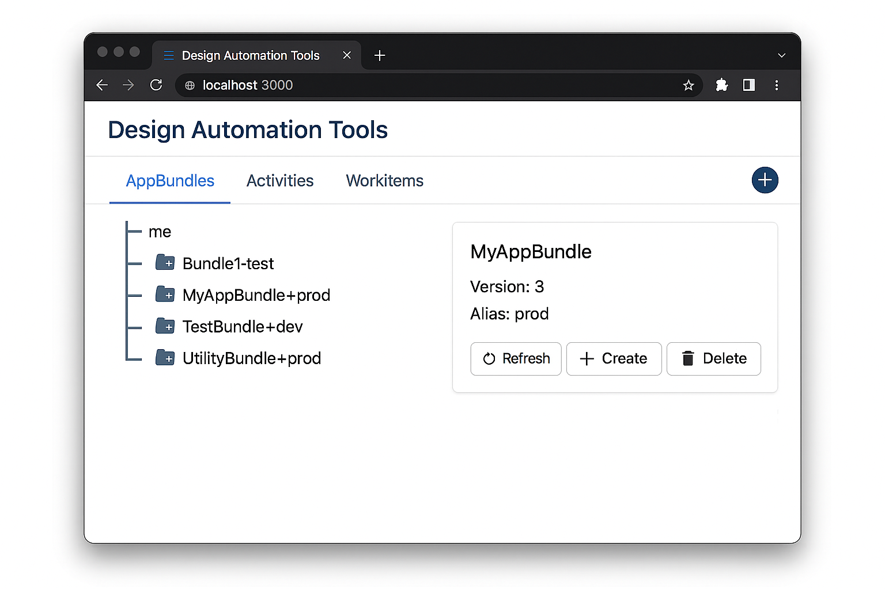
Design Automation Tools
A utility tool for managing APS Design Automation components — allowing you to create, edit, and organize AppBundles, Activities, and WorkItems, including generating new versions and aliases
Purpose:
Automate tasks on Revit, AutoCAD, Inventor, and Fusion files using APS cloud engines.
Real‑Life Use:
Auto‑generate PDFs/DWGs
Batch process drawings
Update parameters or run custom scripts
Modify files without opening desktop apps
Benefits:
Saves time
Reduces manual errors
Scales across large projects
No CAD software needed on the machine

Slide 3
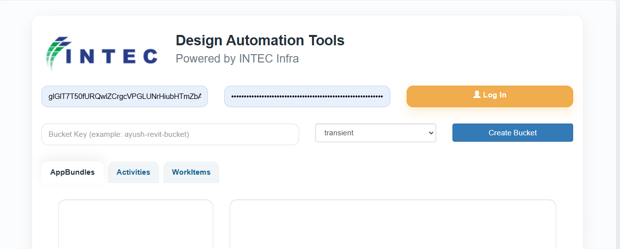
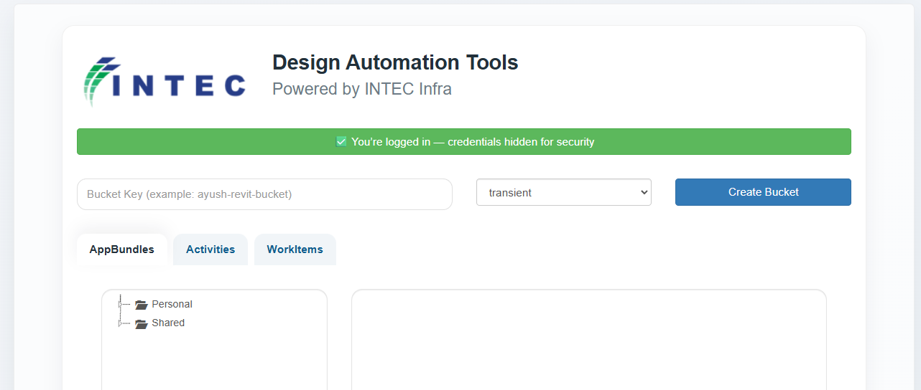
Secure Login & Authentication
What is happening on this screen?
We enter Client ID
We enter Client Secret
Then click Log In
Importance
Security First
Client ID = Like a username for the application
Client Secret = Like a password for the application
Ensures only authorized users can access the automation system
Protects Company Data
Prevents unauthorized access
Keeps design files and automation workflows secure
Ensures only approved systems can run processes
Identity Verification
Confirms that our application is registered with Autodesk
Verifies that requests are coming from a trusted source
Safe Cloud Communication
Creates a secure connection between:
Our Application
Autodesk Cloud
All automation runs under verified identity

Slide 4
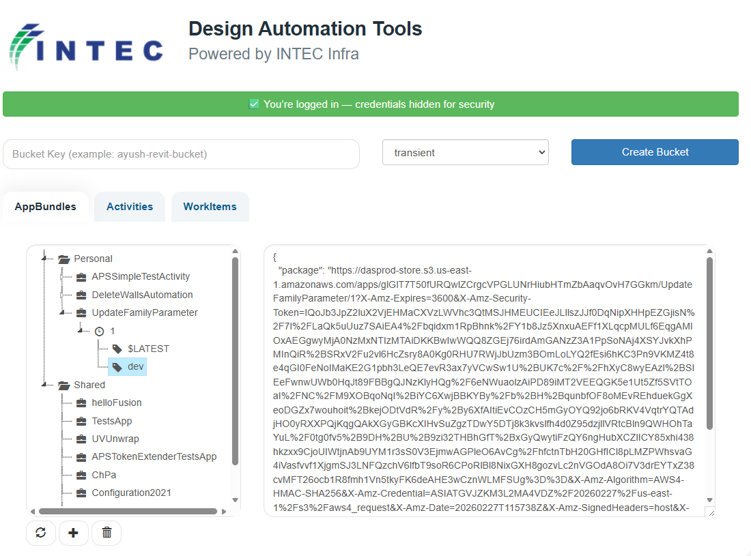
Selecting Automation Script (AppBundles)
An AppBundle is a packaged automation script stored in the cloud.
Think of it as:
📦 A ready-made “automation tool” that performs a specific task automatically.
Examples:
Delete walls automatically
Update family parameters
Run a testing script
Modify design elements
How User Selects Which Script to Run
Choose the required script from the list
Expand it
Select the correct Alias (like "dev")

Slide 5
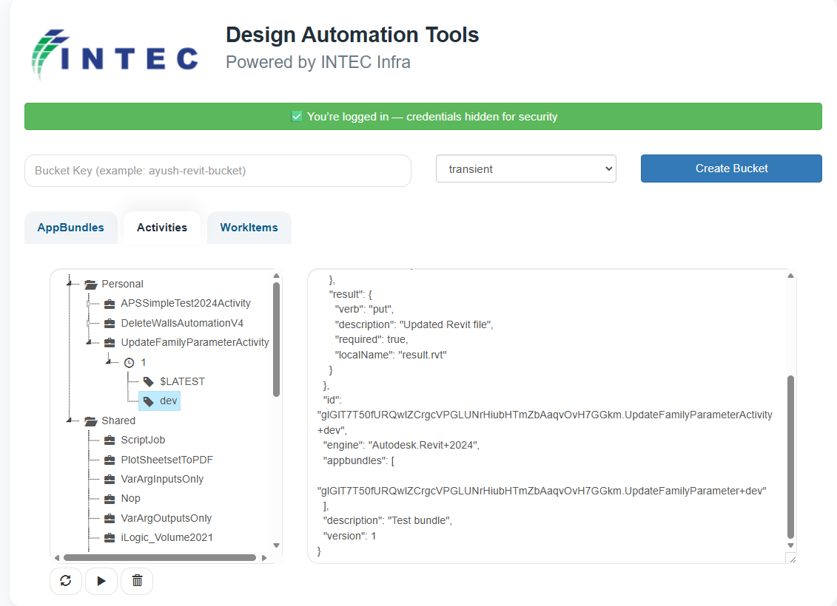
Activity – Defining How the Automation Runs
An Activity defines:
What tool to use
What input file to take
What output file to generate
Which software version to run
If AppBundle is the tool,
then Activity is the instruction manual for how to use that tool.
On the left:
List of available Activities
Example: UpdateFamilyParameterActivity
On the right:
Configuration details
Input file required
Output file generated
Software version (Revit 2024)

Slide 6
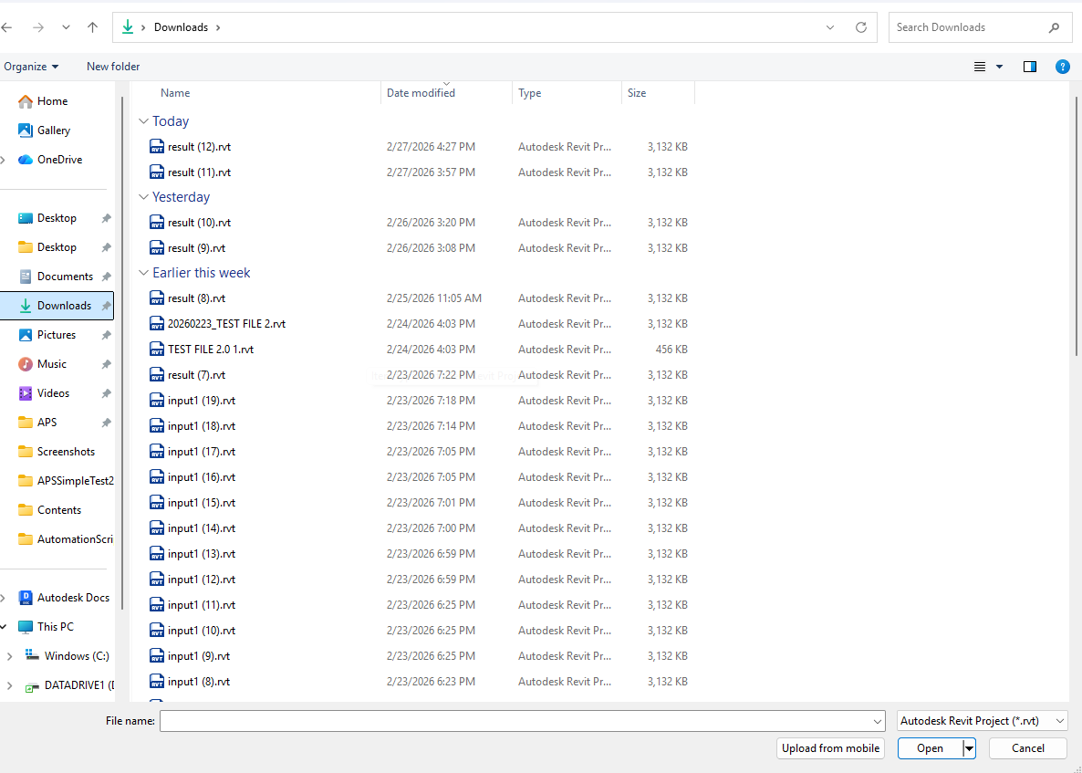
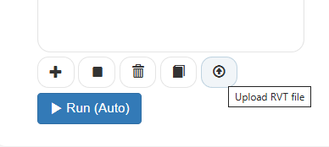
Executing WorkItem(Running Script)
Create a bucket where the files will be stored for processing
After creating bucket use this button to upload the revit file
Select your file to be Uploaded

Slide 7
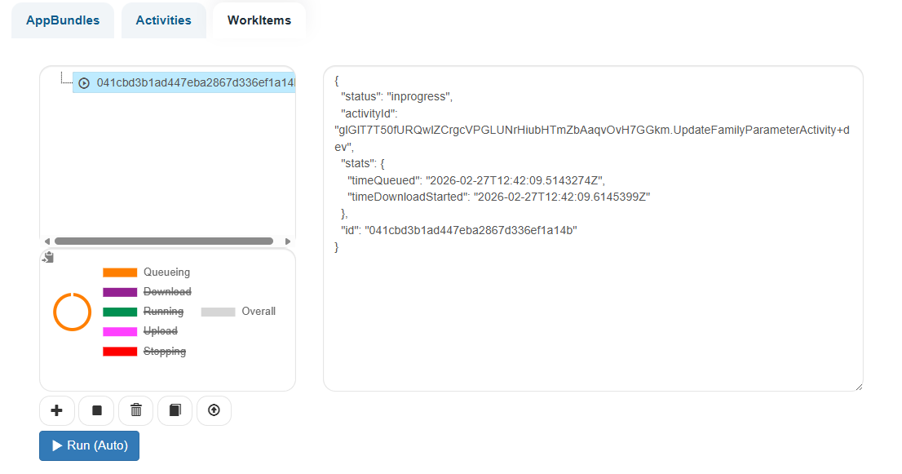
Running Script
Why This is Powerful
No need to open Revit manually
No manual editing required
Runs in the cloud Saves time
Scalable (can run multiple jobs)
Wait for the Script to be Executed

Slide 8
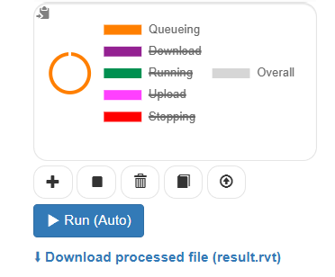
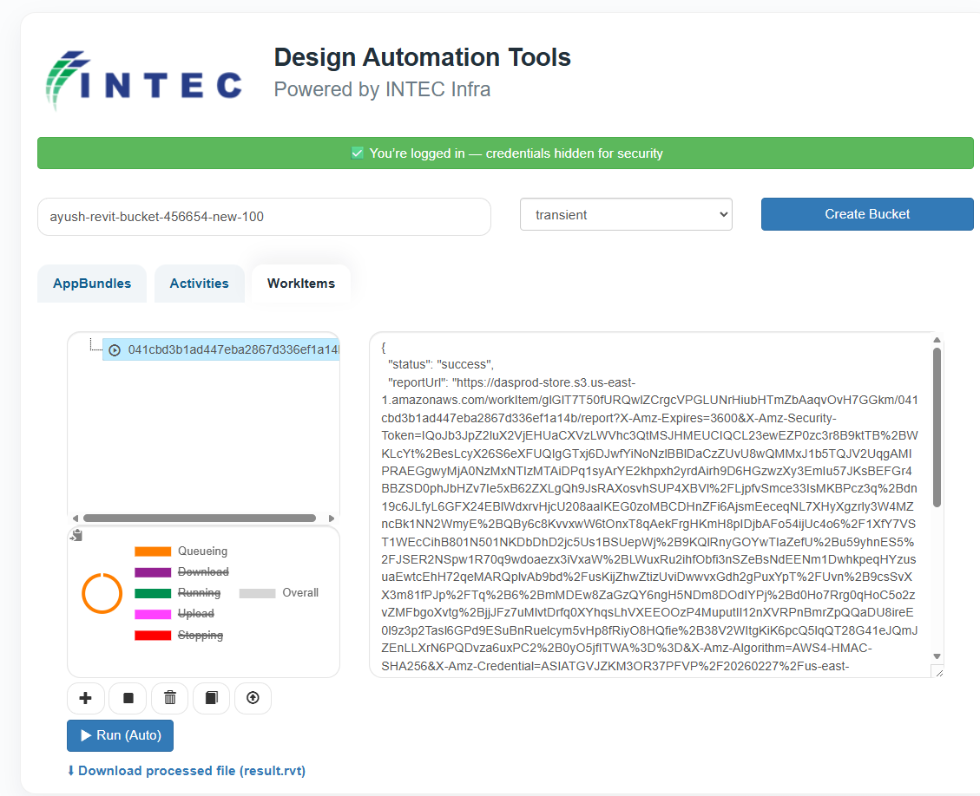
Executed Script
Successful Execution of Script
Download your result file from here

Slide 9


THANK YOU
INDIA
USA
Intec Infra-Technologies Pvt Ltd
Delhi NCR Office
Emaar Digital Greens, Tower B, 14th Floor, Golf Course Extn Road, Sector 61, Gurgaon – 122098, (NCR New Delhi), India T: +91-124-4687900
E: inquiry@intecinfra.com
W: www.intecinfra.com
Intec Americas, Inc. New York Office Bryant Park 104,
West 40th Street 5th Floor,
New York, NY 10018
T: +1 (646) 952 8827 X 8827
E: inquiry@intecamericas.us
W: www.intecamericas.us
Maryland Office
13011 Boswell Court,
Potomac, MD 20854
E: inquiry@intecamericas.us
W: www.intecamericas.us
13

